Slide 1

Electricity markets: trends and future perspectives
Joana Resende, Thereza Aquino

Slide 2
Outline of the Presentation
Introduction
Recent trends and business model innovation
Electricity Markets
Regulatory Challenges
Conclusions

Slide 3
Introduction
Going from a unidirectional value chain....
Source: EDF

Slide 4
Introduction
... to a smart grid system based on Distributed Energy Resources
DECENTRALIZATION
DIGITIZATION
SUSTAINABILITY
BUSINESS MODEL INNOVATION

Slide 5
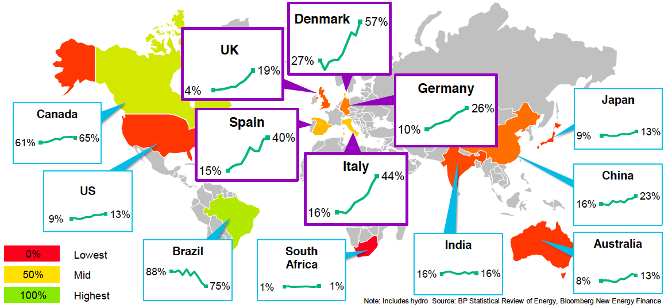
Recent trends and Business Model Innovation
Recent trends
New Electricity Paradigm
More Sustainable (RES)
More efficient (e.g. DSM)
Decentralized
Storage
Electric Mobility
Digital
New business players
RES proportion of power generation (10 years to 2014)
Source: Bloomberg New Energy Finance
Expected pathways to reduction in CO2 emissions from energy
Source: IRENA (2017)

Slide 6
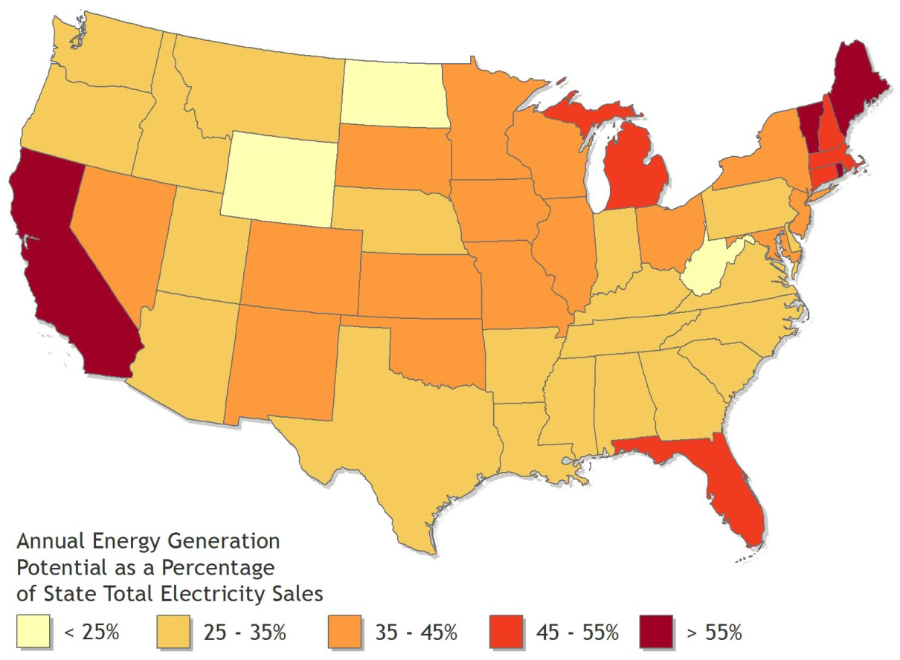
Recent trends and Business Model Innovation
Recent trends
New Electricity Paradigm
More Sustainable (RES)
More efficient (e.g. DSM)
Decentralized
Storage
Electric Mobility
Digital
New business players
Potential rooftop PV annual generation from all buildings
(% of state total 2013 electricity sales)
Source: NREL (2016)
Reduction in LCOE + Easier Grid Parity

Slide 7
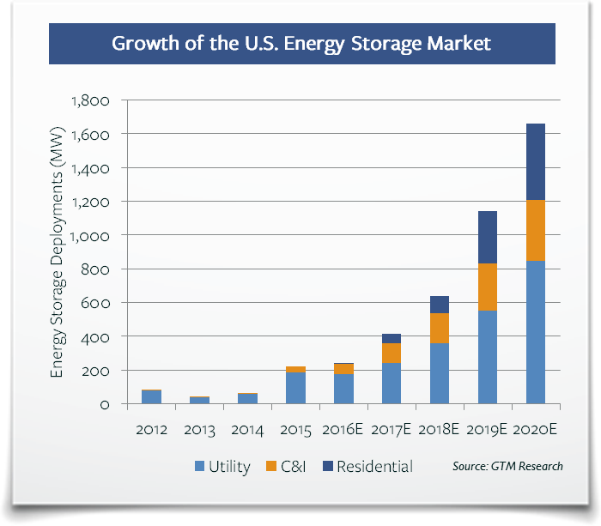
Recent trends and Business Model Innovation
Recent trends
New Electricity Paradigm
More Sustainable (RES)
More efficient (e.g. DSM)
Decentralized
Storage
Electric Mobility
Digital
New business players
Source: GTM Research
Source: The Economist

Slide 8
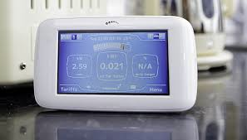


Recent trends and Business Model Innovation
Recent trends
New Electricity Paradigm
More Sustainable (RES)
More efficient (e.g. DSM)
Decentralized
Storage
Electric Mobility
Digital
New business players
Digital Grid Management+ Smart Meeters = Unprecedented sets of Real Time Data
Shift in the operative management paradigm:
  Easier/ Faster detection of system flaws & faster corrections (Self-repairing systems)
  Reduction in technical losses
  Huge investments are needed to build the smart grid
  Need for more coordination between TSO & DSO)
  Shift in the key resources (human capital, data management, cybersecurity)
Notes:
Bariers:
First, the working methods of the typical utility company are built around safeguarding large, long-lived assets and minimizing operational risks. Because of this mind-set, utilities are typically cautious about embracing digital ways of working that involve constant experimentation and could have unintended consequences.
Second, the popular perception of utilities as analog-era companies makes it hard for them to attract people to fill digital-economy roles, such as data scientists. Third, utilities typically have complex legacy operations and IT environments that inhibit rapid innovation.

Slide 9
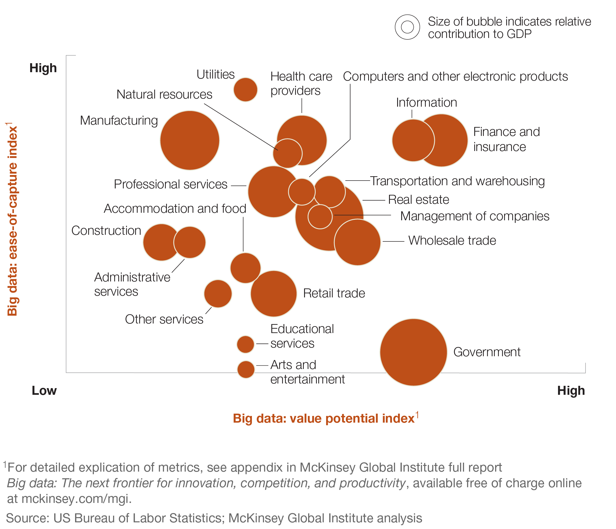
Recent trends and Business Model Innovation
Recent trends
New Electricity Paradigm
More Sustainable (RES)
More efficient (e.g. DSM)
Decentralized
Storage
Electric Mobility
Digital
New business players
Big data: ease of capture and potential value
New business lines
  System reliability services
  Energy efficiency services
  Big Data & Internet of Things – New business Models
Source: McKinsey

Slide 10
Recent trends and Business Model Innovation
Recent trends
New Electricity Paradigm
More Sustainable (RES)
More efficient (e.g. DSM)
Decentralized
Storage
Electric Mobility
Digital
New business players
Source: Bain & Company
Notes:
However, new technologies and methodologies, including energy storage, demand response, distributed resources and virtual power plants, combine to flatten out those demand peaks over time and across systems. This liberates utilities and leads to higher utilization rates of their capital stock, which is itself increasingly virtual. Just as ride-sharing services take a fixed stock of privately owned automobiles and increase utilization levels, so will this wave of digitalization increase the utilization of utilities’ assets by distributing their capacity more efficiently.
his allows for more thorough and effective inspection, along with more accurate predictive maintenance that prevents outages. What’s more, smart systems are increasingly self-repairing. Some, for example, can automatically reroute power around a trouble spot on a grid, similar in concept to the way that packets on the Internet can route around blockage.

Slide 11
Recent trends and Business Model Innovation
Recent trends
New Electricity Paradigm
More Sustainable (RES)
More efficient (e.g. DSM)
Decentralized
Storage
Electric Mobility
Digital
New business players
Utilities’ profit from digital potential
  Smart meters and the smart grid,
  Digital productivity tools for employees,
  Automation of back-office processes.
Source: McKinsey
Notes:
Conservative estimates supported by analysis of real-life cases suggest that digital optimization can boost profitability by 20 to 30 percent. Utilities can realize most of this potential by three means: smart meters and the smart grid, digital productivity tools for employees, and automation of back-office processes.

Slide 12
Recent trends and Business Model Innovation
Recent trends
New Electricity Paradigm
More Sustainable (RES)
More efficient (e.g. DSM)
Decentralized
Digital
Storage
Electric Mobility
New business players
Source: GreenTechMedia

Slide 13
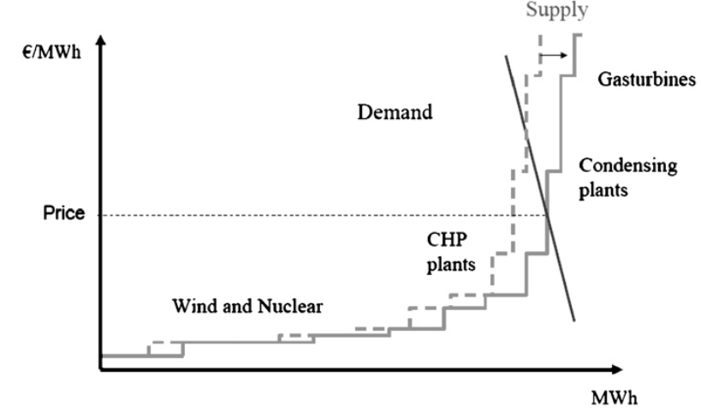
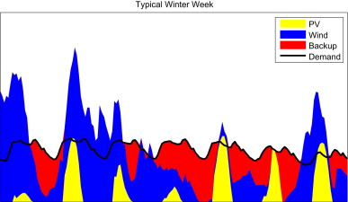
Electricity markets
Current Challenges (The European case)
Increasing weight of RES => Investment and supply security
Price-effect of an increase of the electricity generation using wind.
Source: Vine and Juliani (2014).
Electricity generation and demand during a typical winter week in Italy.
Source: Steinke et al. (2013).

Slide 14
Electricity markets
Current Challenges (The European case)
The entrance of RES in the market
  Lower prices (low marginal cost)
  Increased price volatility (intermittency of
  RES production)
  Gap energy cost & market price (especially
  under special regime pricing mechanisms)
Reduction in average prices=>
Lower investment return
Higher risk => + Return is needed
Capacity Expansion
&
Supply Security
Market price is not a good
investment signal
Notes:
“There is clear evidence that competition has improved efficiency at power plants and improved coordination of operations across a formerly balkanized power grid. But the impact of gas price movements and new technoloies have had a far larger impact”
in Borenstein and Bushnell (2014)

Slide 15
Electricity markets
Current Challenges (The European case)
Some of these questions could be solved by adapting the market design
“In Europe, you compete every minute, 15 minutes or hour to sell a certain volume. In Brazil, you compete to deliver 20/30 years of energy at a defined price”
In Energy Post
http://energypost.eu/europes-energy-investment-crisis-eu-energy-market-needs-makeover/
Competition
Portugal
Brazil
IN the market
FOR the market

Slide 16
Electricity markets
Current Challenges (The European case)
Capacity markets? Auctioning mechanisms? Regulatory pricing mechanisms to guarantee power availability and investment?
Capacity remuneration mechanisms/ Capacity markets
Trade-off :
Investment incentives vs
Market distortions
  Changes investment priorities
  Environmental externalities;
  Competition distortions (national and international)

Slide 17
Electricity markets
Future challenges
Existing problems will be considerably exacerbated by new trends in the electricity sector :
  Strong Intermittency challenges (Decentralized and Intermittent sources, e.g. PV)
  Many more players (very heterogeneous and much smaller - PROSUMER)
  Demand Side Management & Storage (Positive effects on grid congestion)
Digitization & Big Data
  Information management gains
  Sophisticated pricing schemes (more cost-effective with efficiency gains)
  Price regulation under real time pricing?
Towards a service-based paradigm
The Utilities’ Circulation Death Sprial
BUSINESS MODEL INNOVATION

Slide 18
Recent trends and Business Model Innovation
Business Model Innovation
Business Model Innovation (New value proposition) => Towards a service-based paradigm
Innovative funding solutions: customer-centric BM, third-party, solar community
The strong change in the product’s characteristics and the market structure (both on the supply & the demand side) calls for MARKET DESIGN INNOVATION

Slide 19
Recent trends and Business Model Innovation
Business Model Innovation

Slide 20
Regulatory challenges
Utilities’ Death Spiral
Distributed Generation may threaten the utilities’ conventional business model – “Death spiral"
Decentralized Generation (DG)
Upward pressure on tariffs
Reduction in utilities' demand
Negative effect on revenues
Grid parity more favorable to DG
YET...
Utilities’ activity is increasingly challenging:
  Huge investment needs
  Integration of DG production in the grid
  Uncertain decentralized production & intermittent RES
  Coordination among many heterogeneous agents
  Grids’ reliability & resilience
  Facilitate coordination among many new heterogeneous problems
Utilities’
Death
Spiral
&
Cross-Subsidy
Notes:
Referid que o efeito negativo nas receitas existe mm nos mercados regulados pois demora tempo a que estas perdas sejam reconhecidas nas tarifas.
Referir aqui também que há os três modelos

Slide 21
Regulatory challenges
Balancing Solar PV incentives & Utilities financial viability
Necessary regulatory challenges in the next 10 years according to utilities’ managers:
Utilities’ major concern in the short-run - Tariff & pricing tools
Re-designing conventional tools
Market Design Innovation
Source: Accenture (2016)

Slide 22
Regulatory challenges
Redesigning conventional tools: tariff structure
Tariff structure
  Towards non-linear pricing schemes:
    Change the current (mostly) volumetric system
    Cost-reflective system (that accounts for the different costs imposed on the network by different profiles of users)… the case of telecoms?

Slide 23
Regulatory challenges
Redesigning conventional tools: tariff structure
Tariff structure
  Dynamic tariffs (ERSE’s pilot project)
    Critical peak pricing
    Critical peak rebate
    Real time pricing…
    Cost-effectiveness
    Complexity of the tariff design process
    Sophisticated metering/ communication systems
    Sophisticated and Tech-savvy consumers
    Social impact
Source: Environmental Defense Fund (blog)

Slide 24
Regulatory challenges
Redesigning conventional tools: new market design
Regulation tools
Design appropriate incentives for DG investments
Fiscal incentives
Energy National Policy
DG
Incentives
Grid Access
Socio-economic benefits
Access to credit
Source: Own elaboration based on IRENA (2017), Overview of the types of renewable energy policies and measures adopted

Slide 25
Regulatory challenges
Redesigning conventional tools: new market design
Create appropriate (market) mechanisms to remunerate DG
  Feed-in tariffs?
  Net Metering?
  Net Billing?
  Wholesale market price?

Slide 26
Regulatory challenges
Redesigning conventional tools: new market design
Source: Dethlefs, Preisler, Renz (2015)

Slide 27
Conclusion
Electricity markets are already suffering deep challenges
  The most visible face is the entry of RES (lower expected prices+higher volalility)
  Discussions on New Market Design => Capacity investment & Supply Security
New electricity paradigm: more sustainable, more decentralized, digital, storage, demand-side response, electric mobility, …
  Key changes in product(s) characteristics => Towards a service-based paradigm (third-party models, prosumers, community solar, energy management systems, batteries, EV,…
  Deep change in the market structure (Demand & Supply)
    Demand side management
    From the Vertically Integrated Utility to a market with many heterogeneous players (often rather small – e.g. prosumer, energy efficiency consulting & other economic giants intersecting other activity areas – ICT, Internet Giants, Automotive Sector, Electronics….
  Regulation and an appropriate Market Design is key to address current challenges and promote a smooth transition to the new electricity paradigm.
Notes:
Regra inicial: ICMS em toda a energia consumida
Convênio 16/2015: ICMS somente sobre a diferença (mesma PF ou PJ)
Lei no 13.169/15: PIS/COFINS somente sobre a diferença (mesma PF ou PJ) Isenções não se aplicam: geração compartilhada, condomínios e GD > 1 MW (ICMS)

Slide 28
THANK YOU!!!
OBRIGADA!!!!
jresende@fep.up.pt

